Slide 1
Market Research Student Poll
Notes:
Market research Student Poll

Slide 2
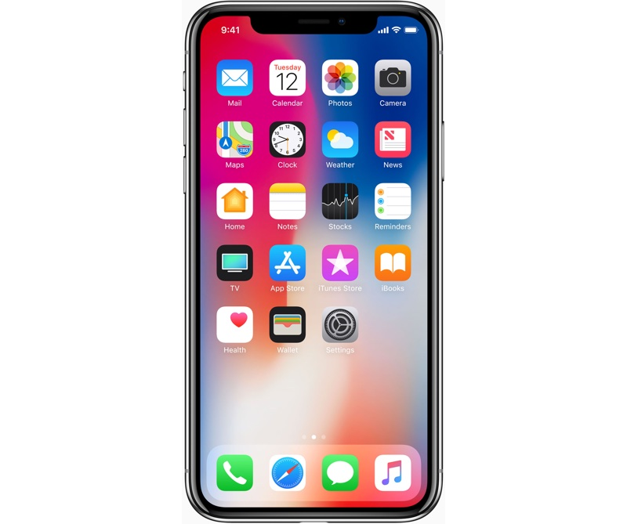



Select Your Account
Tutor
Student
Tutor
Student
or
Notes:
THE STUDENT CAN GIVE A RATING AFTER THE SESSION IS OVER

Slide 3
Login Student Account
Login Student Account
Student ID
u
Password
LOGIN
Notes:
THE STUDENT NEEDS TO INPUT THE USERNAME AND PASSWORD IN

Slide 4

Create Student Account
First Name
Last Name
Email Address
Password
Course name
i
Register
LOG IN
Notes:
THE STUDENT CAN CREATE AN ACCOUNT IF NOT REGISTERED BY ENTERING THEIR DETAILS AND COURSE NAME TO IDENTIFY WHICH TUTOR GROUP THEYLL BE IN.

Slide 5



Request a Session
How can we help
i
Student’s Name
Student’s School Year
Subject required?
Request:
Post
PROFILE
FIND A TUTOR
MESSAGE TUTOR
MORE
Notes:
POST A JOB TO FIND A TUTOR TO HELP THE STUDENT.

Slide 6




Profile
picture
Student Name
Rating?
Bio
Feedback
Student Bio
i
PROFILE
FIND A TUTOR
MESSAGE TUTOR
MORE
Notes:
FIND A MATCH BETWEEN THE TUTOR AND PARENT WITH A PROFILE PAGE

Slide 7

BACK
Student Name
Picture
MORE
Tutor
Tutor
Tutor
cv
Message
Send
PROFILE
FIND A TUTOR
MESSAGE TUTOR
MORE
Notes:
BOTH USERS (PARENT & STUDENT) CAN COMMUNICATE USING THIS CHAT INTERFACE.

Slide 8

Feedback
Your last session
Friday 10, 2017 18:00
i
Please leave a review
Picture
Tutor Name
Payment Amount
Leave a comment
Submit
PROFILE
FIND A TUTOR
MESSAGE TUTOR
MORE
Notes:
USER (PARENT OR STUDENTS) CAN RATE THE TUTOR AFTER THE SESSION.

